Slide 1
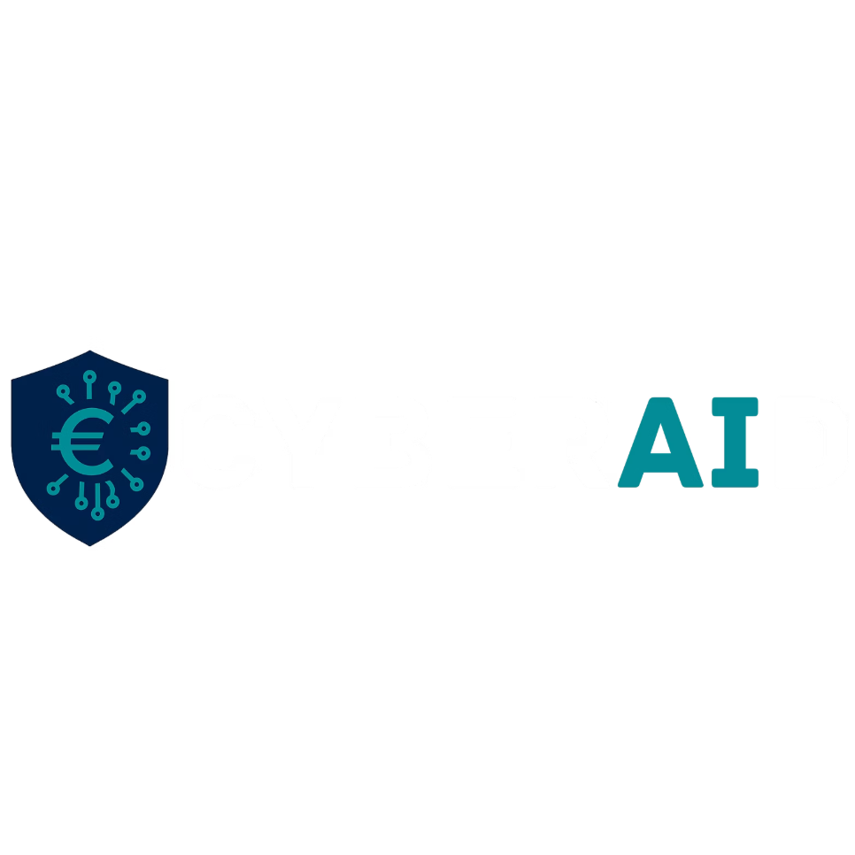


AI-Driven Cybersecurity for
Financial Service Providers
CyberAId
General Presentation
Date - Place
The project funded under Grant Agreement No 101249596 is supported by the European Cybersecurity Competence Centre

Slide 2
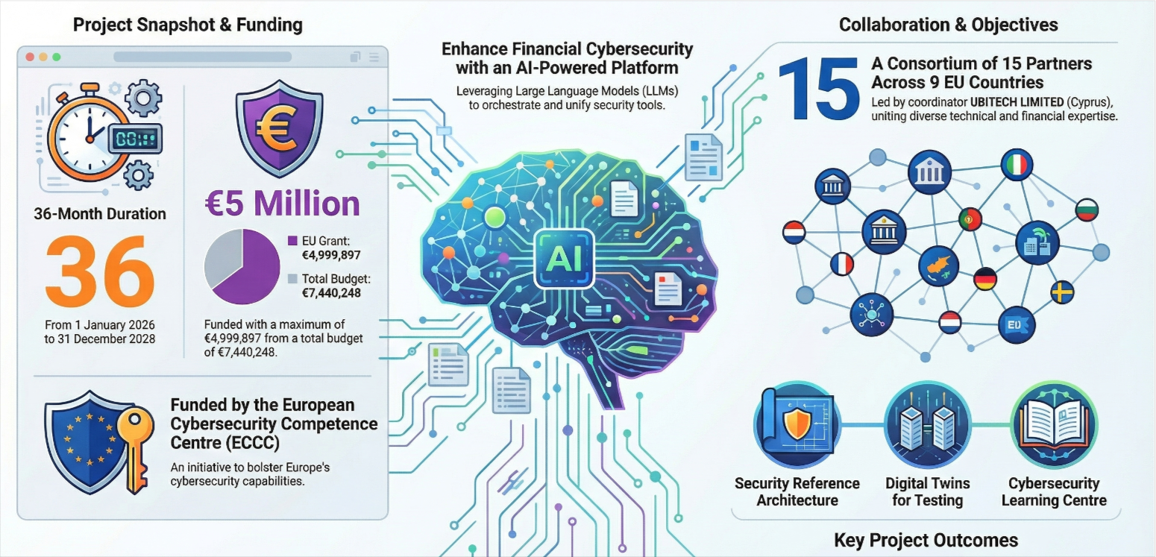
Project at a Glance

Slide 3
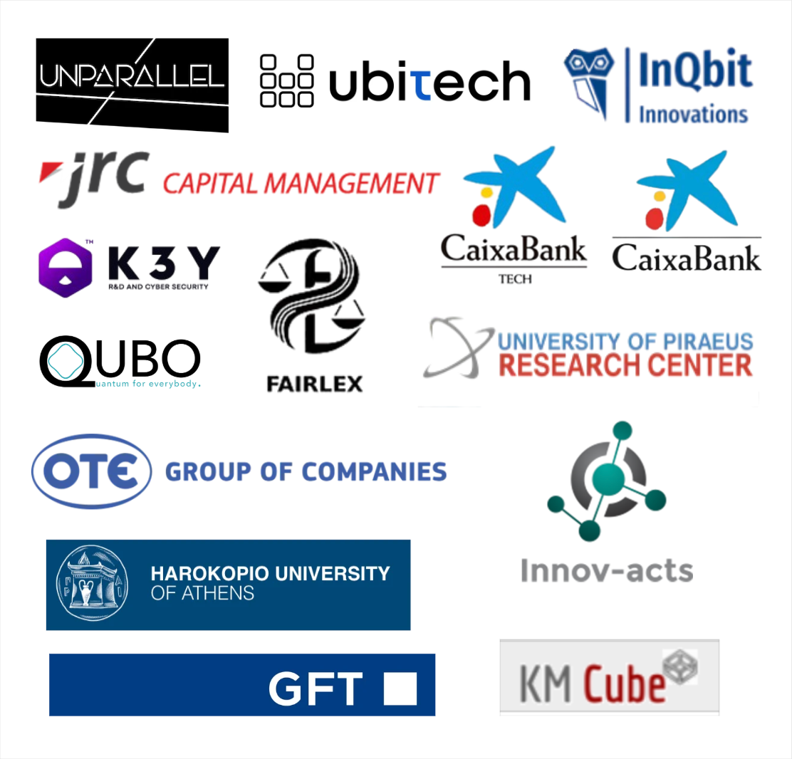
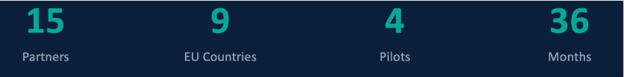
Consortium

Slide 4





Background and Motivation
1. Sophisticated threat actors targeting high-value assets
2. Stringent regulatory requirements stemming from general purpose regulations and directive (DORA, NIS2, GDPR)
3. Quite complex sector specific regulations with cybersecurity implications (e.g., PSD2, AML)
4. Complex digital supply chains with thousands of third-party connections
5. Legacy systems integration issues, which increase the attack surface of the digital systems used within Critical Infrastructures (CI) of the finance sector
6. Emergence of new vulnerabilities as a result of the deployment and use of a host of novel digital systems and technologies (e.g., AI/GenAI).
Current Gaps | Pain Points
Cyber Defences are Fragmented & lack Context-awareness
Low Automation in Vulnerability Discovery & Compliance
Limited Access to Secure & Realistic Testing Environments
Underexploited Potential of LLMs as Cyber Defence Enablers
Security Gaps in AI Threat Modelling & Legacy Integration

Slide 5


CyberAId Goals
Significantly enhance the cyber-resilience of European Critical Infrastructures (CIs), particularly within the finance sector
Develop and deploy a novel agentic AI infrastructure that autonomously and intelligently orchestrates a pool of state-of-the-art cybersecurity tools to address the entire security lifecycle

Slide 6
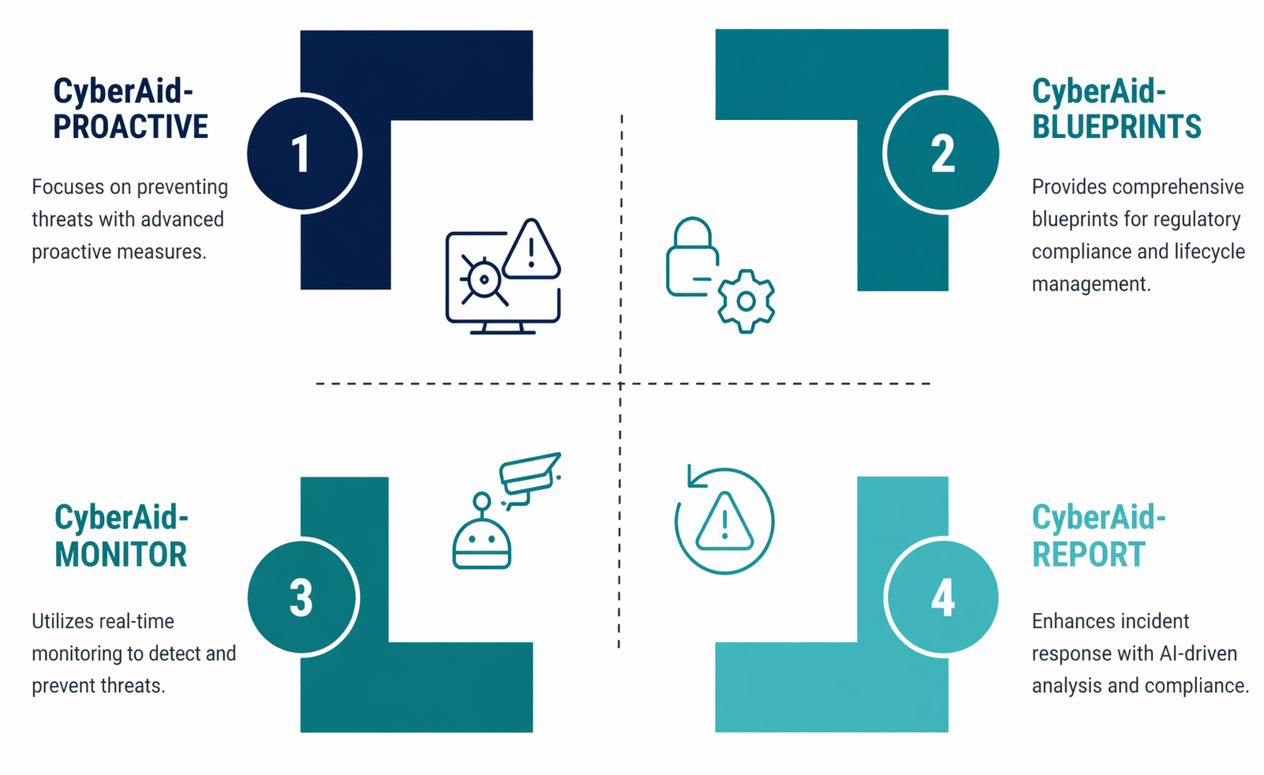
CyberAId Innovations

Slide 7
Requirements and Blueprints
Functional Requirements
Security and Compliance
Technical Requirements
AI-driven orchestration
Real-time monitoring
Automated response
System integration
EU cybersecurity alignment
Security ESRs
Data protection
Auditability
Scalable architecture
Interoperability
High performance
Distributed systems

Slide 8
CyberAId Platform Overview
REPORT
Handles incident
reporting and
response coordination
MONITOR
APIs
Facilitates seamless
integration with
existing systems
Involves continuous
surveillance and
threat monitoring
PROACTIVE
Learning
Center
Focuses on early
threat detection and
vulnerability management
Provides educational
resources and
training

Slide 9
CyberAId Pilots & Use Cases
Tiered Client Impersonation Detection for Private Banking and Trading Systems
Advanced Anti-Money Laundering Detection for Payment Service Providers
01
02
Partners: KM3, INNOV, HUA, UBI, QUBO
Partners: OTE, GFT, UBI, K3Y
An impersonation detection system leveraging email content analysis, federated learning across institutions, adaptive monitoring, and LLM-based contextual reasoning. The approach will enable even smaller financial institutions to benefit from collective intelligence without compromising client data privacy.
Creation of a multi-layered AML detection system that significantly improves accuracy while reducing false positives. Advanced anomaly detection, and LLM-powered contextual reasoning, to detect sophisticated money laundering patterns that traditional systems miss, particularly in e-wallet and card payment ecosystems.
AI-Enhanced Anomaly Detection and Incident Response for Banking Cybersecurity
Cyber-Resilient AI-Powered Threat Detection and Risk Modelling for High-Frequency Trading
03
04
Partners: CAIXA, UPRC, K3Y, UNP
Partners: JRC, GFT, UBI, IQB, UNP
Identifying subtle anomalies across banking channels and streamlining the incident response process through intelligent automation and decision support.
Protection through a complete trading operation lifecycle from market data ingestion to algorithmic signal generation to client portfolio execution.

Slide 10
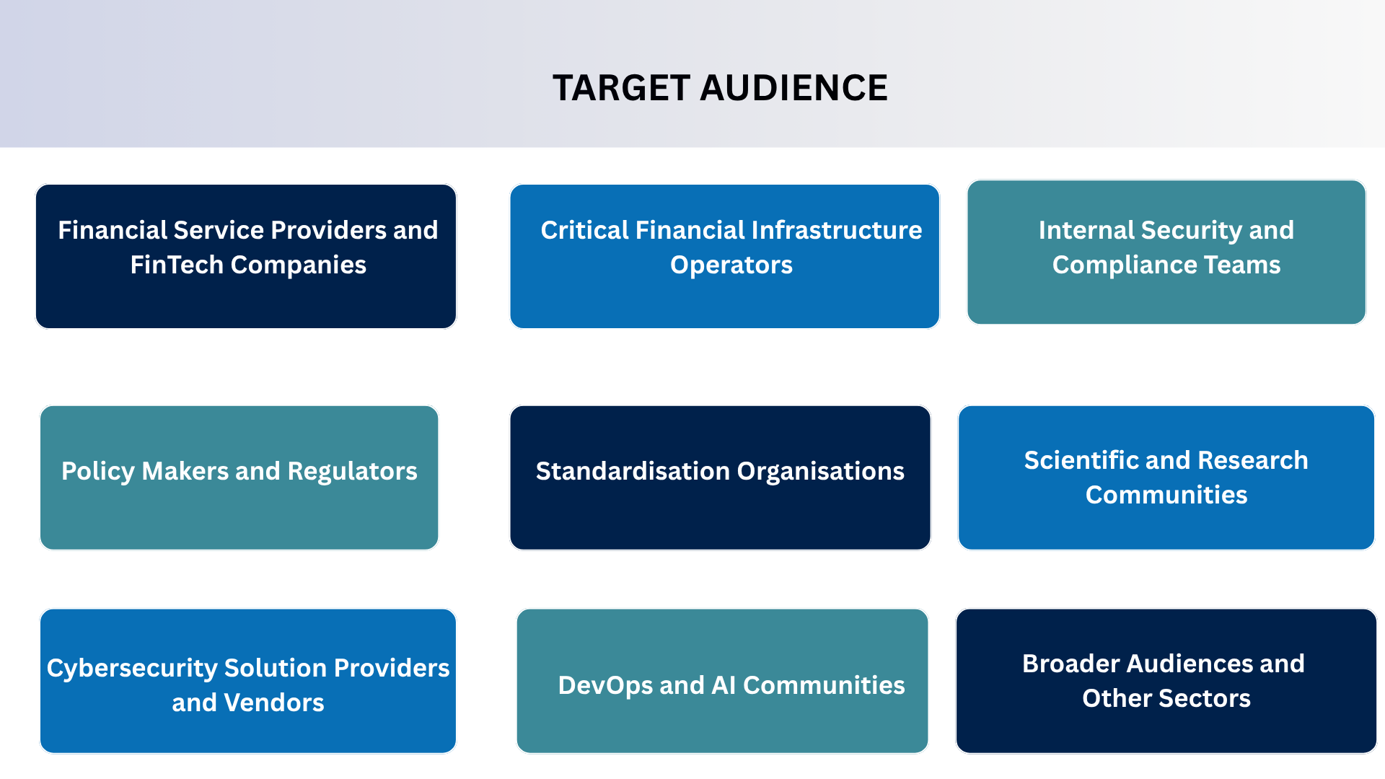
Target Audience

Slide 11


Expected Impact
Deployment of state-of-the-art technologies in cybersecurity for financial institutions
PROACTIVE
Prevent & Prepare
AI-driven security infrastructure using LLM orchestration
Digital twins for risk-free security testing
Automated threat detection
Advanced monitoring of financial networks using eBPF technology
MONITOR
Detect & Analyze
Data protection through privacy-preserving analytics
Incident response with LLM-guided investigation
Reduction in vulnerability identification time
Alignment with DORA, NIS2, GDPR, ISO 27000
Faster incident response and resolution times
Cross-institutional threat intelligence sharing without privacy compromise
REPORT
Respond & Report

Slide 12
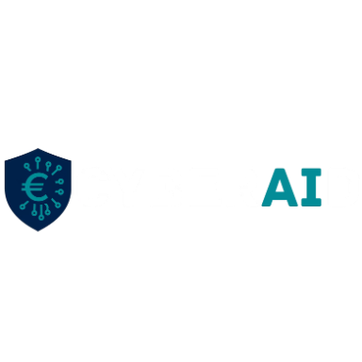
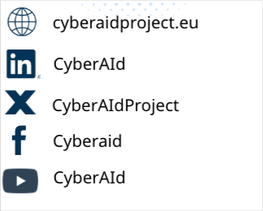

Thank you!
Connect With CyberAId:
The project funded under Grant Agreement No 101249596 is supported by the
European Cybersecurity Competence Centre

