Slide 1
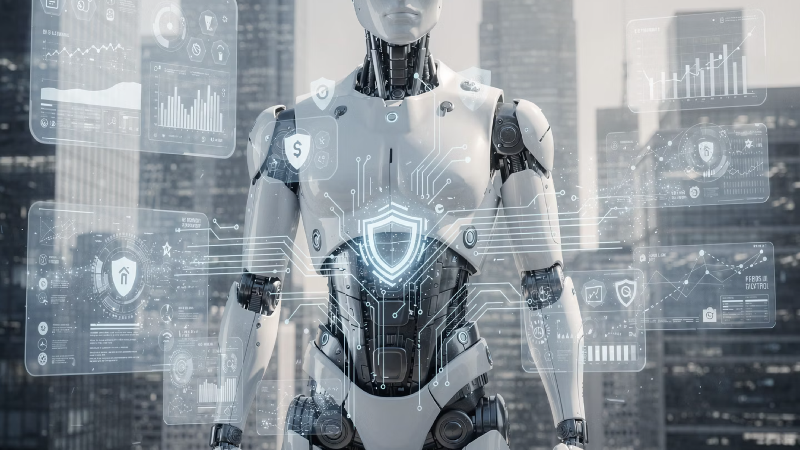
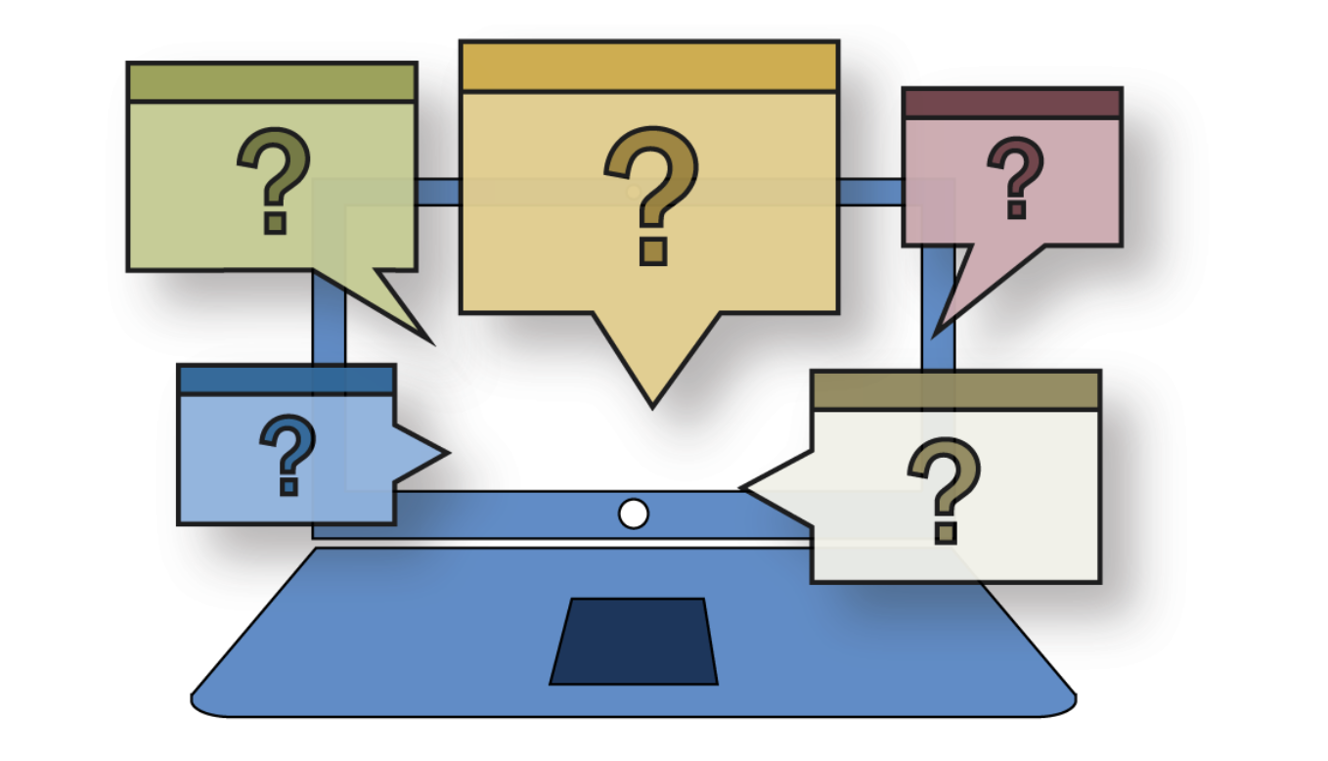
Quantum Finance Quiz

Slide 2
What is the primary concern associated with the 'Harvest Now, Decrypt Later' (HNDL) threat in the financial sector?
A. Adversaries utilise current classical computers to break quantum-encrypted tokens in real-time.
B. Adversaries use quantum computers to intercept and delete classical data before it reaches its destination.
C. Adversaries collect encrypted data today to decipher it once sufficiently powerful quantum computers are available.
D. Adversaries harvest quantum keys to disrupt the physical infrastructure of traditional banking data centres.

Slide 3
Why is Post-Quantum Cryptography (PQC) considered more suitable for near-term adoption in banking than Quantum Key Distribution (QKD)?
A. PQC can be implemented on existing classical hardware and software without requiring new physical infrastructure.
B. PQC eliminates the need for any mathematical complexity by using polarized photons for data transmission.
C. PQC is the only method capable of protecting data against 'Harvest Now, Decrypt Later' attacks.
D. PQC uses the laws of physics to guarantee that any attempt at eavesdropping is physically impossible.

Slide 4
Which quantum-inspired algorithm is expected to significantly enhance credit risk evaluation by processing multiple scenarios simultaneously?
A. Hamming Quasi-Cyclic (HQC)
B. Quantum Monte Carlo
C. Grover's Algorithm
D. Shor's Algorithm

Slide 5


In the Post-Quantum Financial Infrastructure Framework (PQFIF) inequality X+Y>Z, what does the variable Y represent?
A. The required security shelf-life of the archived data.
B. The total economic loss expected from a systemic cryptographic failure.
C. The time required to migrate the cryptographic infrastructure to a new standard.
D. The estimated time until a cryptographically relevant quantum computer is realized.

Slide 6
What was a primary achievement of Project Leap's first phase, led by the BIS Innovation Hub and European central banks?
A. Completely replacing all classical RSA-2048 encryption across the global SWIFT network.
B. Developing a quantum computer capable of breaking current AES-128 encryption standards.
C. Establishing a quantum-resistant, hybrid-encrypted communication tunnel between central bank IT systems.
D. The successful creation of the world's first unforgeable physical quantum currency for retail use.

Slide 7
How does Quantum Key Distribution (QKD) identify the presence of an eavesdropper during the key exchange process?
A. Attempts to measure or intercept the quantum states perturb them, introducing detectable transmission errors.
B. The system uses AI-driven algorithms to scan for suspicious IP addresses along the fibre-optic route.
C. The system automatically slows down data rates to 800 Gbps to allow for manual inspection of packets.
D. It requires a physical 'trusted node' to verify the digital signature of every photon sent.

Slide 8
Which NIST standard is intended to replace classical digital signatures (like RSA and ECDSA) to secure institutional cryptocurrency wallets?
A. ML-DSA (FIPS 204)
B. ML-KEM (FIPS 203)
C. SHA-256
D. HQC (Hamming Quasi-Cyclic)

Slide 9
What is meant by the term 'crypto-agility' in the context of modernising financial infrastructure?
A. The ability of a system to rapidly adapt or switch cryptographic mechanisms without requiring a total infrastructure overhaul.
B. The physical flexibility of fibre-optic cables used in metropolitan QKD networks.
C. The speed at which quantum computers can perform transactions compared to traditional banking ledgers.
D. A metric used to measure the power and error-correction capability of a noisy intermediate-scale quantum device.

Slide 10
According to McKinsey's analysis, what is the estimated potential economic value of quantum computing in the finance industry by 2035?
A. Less than $10 billion due to the high total cost of ownership for QKD hardware.
B. Approximately $150 trillion, matching total annual global payment flows.
C. Between $400 billion and $600 billion.
D. Exactly $12 billion, aligning with the annual tech spend of major global firms.

Slide 11
Which of the following is a unique property of 'Quantum Money' or 'Quantum Tokens' as described in the source materials?
A. They allow for transactions to occur instantly without the need for a network connection.
B. They are digital assets that can be accessed without any form of cryptographic key.
C. They automatically double in value every time a new qubit is added to the central bank's quantum computer.
D. They use quantum mechanics to embed security features that make physical replication or forgery impossible.

Slide 12

Quiz Answers
1-C
2-A
3-B
4-A
5-C
6-A
7-A
8-A
9-C
10-D

